Slide 1
GIT Fundamentals
RAGHUNATHAN

Slide 2
Version control system
Version control, also known as source control, is the practice of tracking and managing changes to software code. Version control systems are software tools that help software teams manage changes to source code over time. As development environments have accelerated, version control systems help software teams work faster and smarter. They are especially useful for DevOps teams since they help them to reduce development time and increase successful deployments.

Slide 3
Types of Version Control Systems
1. Local Version Control System:
This follows a simple and very common approach, which is to maintain track of files within the local system. However, this VSC is quite prone to errors as there are high chances of accidentally writing to the wrong file
2. Centralized Version Control Systems
CVCS has a single server containing all versions of the code files, which are often stored in the repositories, backup files, and all the contributors (those programmers working on the code file) for the main project.
3.Distributed Version Control Systems
In DVCS, there is more than one server that contains the code files. Examples of Distributed Version Control System are Bazaar, Git, and Mercurial. The code files in DVCS are mirrored on the computer of every contributor. This means that every contributor has its own code version, including full history to work locally.
In Distributed Version Control, different groups of people from different physical locations are allowed to collaborate simultaneously within the same project. This gives DVCS an edge over centralized version Control Systems.

Slide 4
Source Code Management
Source code management is the practice of tracking modifications to source code. Keeping a running history of the changes made to a codebase helps programmers, developers and testers ensure that they’re always working with accurate and up-to-date code and helps resolve conflicts when merging code from multiple sources.
Source code management solves these problems by tracking each developer’s changes, highlighting conflicts and preventing code overwriting. Developers are alerted to any conflicts so they can address them before they are merged into the source code and potentially compromise the application.

Slide 5
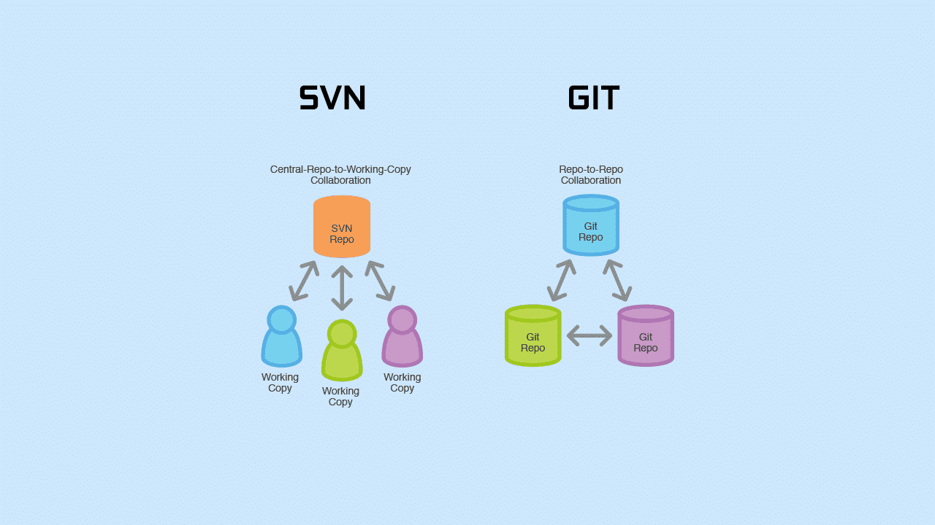
SVN vs GIT

Slide 6
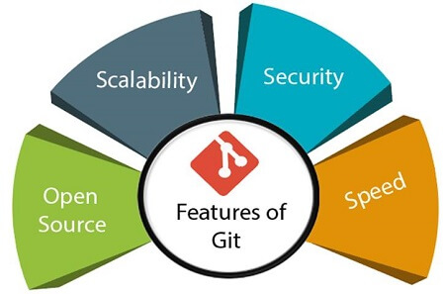
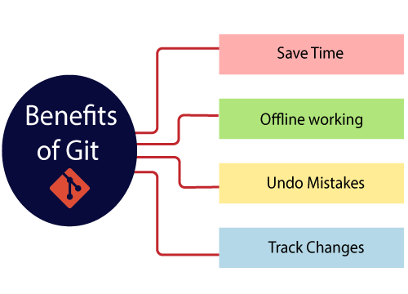
GIT
Git is an open-source distributed version control system. It is designed to handle minor to major projects with high speed and efficiency. It is developed to co-ordinate the work among the developers. The version control allows us to track and work together with our team members at the same workspace.
Git is foundation of many services like GitHub and GitLab, but we can use Git without using any other Git services. Git can be used privately and publicly.

Slide 7
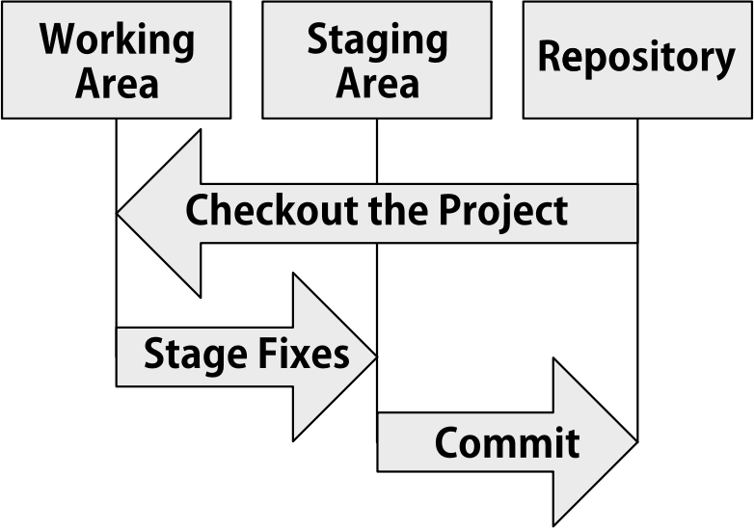

Slide 8
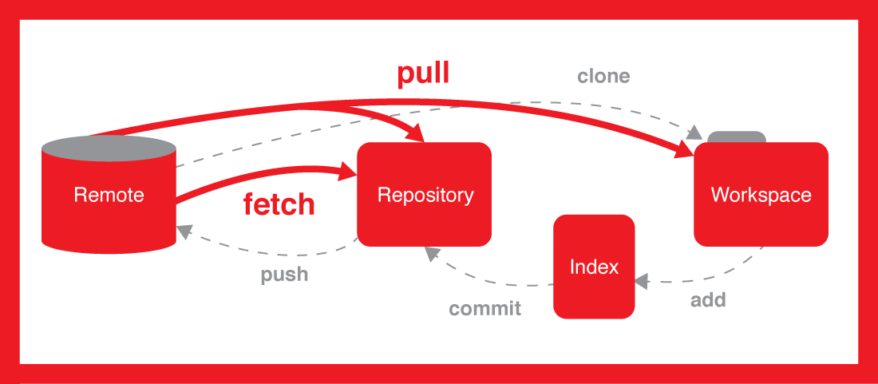

Slide 9
git pull, in contrast, is used with a different goal in mind: to update your current HEAD branch with the latest changes from the remote server. This means that pull not only downloads new data; it also directly integrates it into your current working copy files
git pull origin master

Slide 10
$ git fetch origin
git fetch really only downloads new data from a remote repository - but it doesn't integrate any of this new data into your working files. Fetch is great for getting a fresh view on all the things that happened in a remote repository.

Slide 11
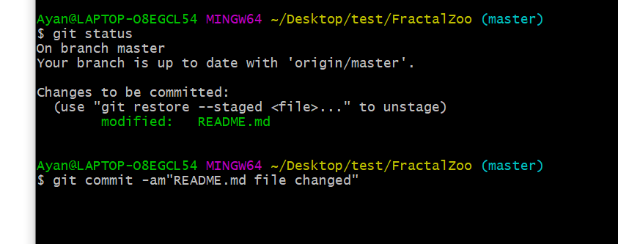

Slide 12
Git stash
$ git stash
And you can view all of your stashes with the following command
$ git stash list
And if you need a apply a stash to a branch, simply use apply
$ git stash apply
This Git command temporarily stores your modified files. You can work in stashed with the following Git command

Slide 13
git push
$ git push -u <short_name> <your_branch_name>
Example
$ git push -u origin feature_branch
You should have origin and upstream set up before you use Git push. And here is the command to set up upstream.
Usage
$ git push --set-upstream <short_name> <branch_name>
Example
$ git push --set-upstream origin feature_branch
Once you are connected with the remote repository (with the help of the git remote command), it's time to push your changes to that repository.

Slide 14
Git remote
Git remote command acts like a border, and If you need to connect with the outside world, you have to use the Git remote command. This command will connect your local repository to the remote.
Usage
$ git remote add <shortname> <url>
Example
$ git remote add origin https://dev.azure.com/aCompiler/_git/DemoProject

Slide 15
git checkout
This Git command is used to switch between branches. This is one of the powerful git commands and can use used as a swiss knife,
Usage
$ git checkout <branch_name>
Also, you can create and checkout to a branch in a single like, here is the usage for that
$ git checkout -b <your_new_branch_name>

Slide 16
git branch
Usage
(i) To list all branches:
$ git branch
(ii) To create a new branch:
$ git branch <branch_name>
(iii) To delete a branch:
$ git branch -d <branch_name>
Most of the time, you have multiple branches in your Git repository. In simple terms, the branch is an independent line of code development.

Slide 17
git clone
The git clone command will use an existing repository to copy. There is one main difference between the git init and git clone.
git clone <your project URL>

Slide 18
git config
Git config command is super helpful. Especially when you are using Git for the first time, or you have a new Git installation
$ git config --global user.name "Your name"
$ git config --global user.email "Your email"

Slide 19
git init
This is probably the first command you use to start a new project in Git. This command will create a blank new repository,
$ git init
Or you can use the repository name with your git init command.
$ git init <your repository name>

Slide 20
git add
$ git add your_file_name (it will add a single file to your staging area)
$ git add * ( this option will add all the modified and new files to the staging area)
The Git add command will add all the new code files or modified files into your repository. This command offers different options to add files and folders.

Slide 21
git log
$ git log
By default, it will show you all the commits of the currently checked out branch, but you can force it to see all the commits of all the branches with all options.
$ git log --all
With the help of the Git log, you can see all the previous commits with the most recent commit appear first.

Slide 22
git shortlog
git shortlog
The shortlog command shows you a summary from the Git log command. This command is helpful if you are just interested in the short summary.

Slide 23
git show
Compared to the Git log, this command git show will show you details about a specific commit.
$ git show <your_commit_hash>

Slide 24
git rm
$ git rm <your_file_name>
Sometimes you need to delete files from your codebase, and in that case, you can use the Git rm command.
It can delete tracked files from the index and the working directory

Slide 25
git merge
$ git merge <branch_name>
This command will merge the <branch_name> into your current selected branch.
Git merge helps you to integrate changes from two branches into a single branch.

Slide 26
git rebase
$ git rebase <base>
Git rebase similar to the git merge command. It integrates two branches into a single branch with one exception. A git rebase command rewrites the commit history.
You should use the Git rebase command when you have multiple private branches to consolidate into a single branch. And it will make the commit history linear.

Slide 27
git archive
$ git archive --format zip HEAD > archive-HEAD.zip
It will create a zip archive of the current revision.
Git archive command will combine multiple files into a single file. It's like a zip utility, so it means you can extract the archive files to get individual files.

Slide 28
git tag
$ git tag -a v1.0.0
In Git, tags are helpful, and you can use them to manage the release. You can think of a Git tag like a branch that will not change. It is significantly more important if you are making a public release.

Slide 29
git verify-commit
The git verify-commit command will check the gpg signature. GPG or “GNU Privacy Guard” is the tool used in sign files and contains their signatures.
$ git verify-commit <commit>

Slide 30
git diff
i) to compare the working directory with the local repo:
$ git diff HEAD <filename>
ii) to compare two branches:
$ git diff <source branch> <target branch>
Most of the time, you need to compare two git files or branches before you commit or push. Here is a handy command to do that.

Slide 31
git clean
You can deal with untracked files by using the Git clean command. You can remove all the untracked files from your working directory by using this command
$ git clean

Slide 32
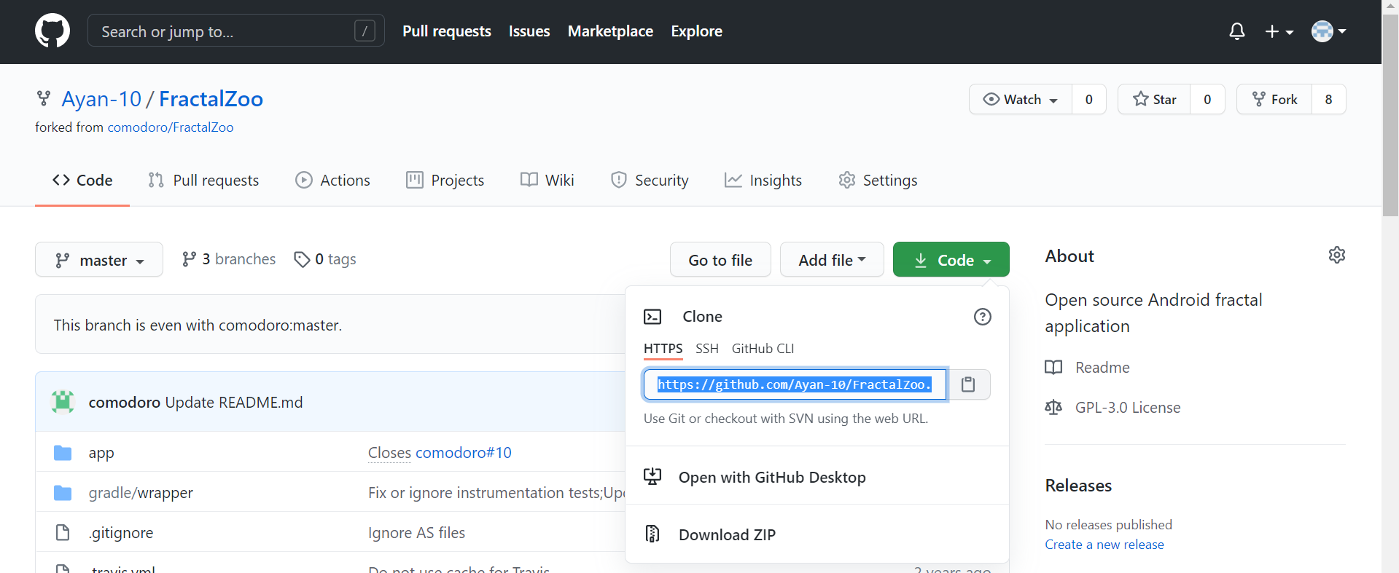
Fork
Forking any repository means make a copy of a real repository in your GitHub account and make changes in your copy. Thus, a real repository won’t get affected by your code changes

Slide 33
Git Troubleshooting & Best Practices
1. Discard Local File Modifications
Working with the code can be the greatest way to understand a problem. However, sometimes, the changes done throughout the procedure could be better, so returning the file to its previous state is the fastest and easiest approach
2. Clean Up Local Commits Before Pushing
Git rebase –interactive origin branch
3. Reverting pushed commits
Git revert –n head

Slide 34
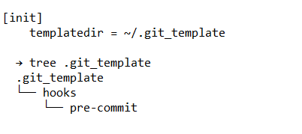
4. Avoid Repeated Merge Conflicts
Addressing merge conflicts can be difficult, but addressing the same issue repeatedly (e.g., in long-running feature branches) is frustrating. If you’ve experienced this, you’ll like the reuse recorded resolution feature. Add it to the global config for all projects
Git config –global rerere.enabled true
5.Avoid Common Mistakes With Git Hooks
Some mistakes are repeated but can be avoided by executing checks or cleanup actions at a specific git workflow stage
It is precisely the case for which hooks were intended. First, add an exe file to .git/hooks to establish a hook

Slide 35


Slide 36
Branching strategy
Release branching
Release branching refers to the idea that a release is contained entirely within a branch. This means that late in the development cycle, the release manager will create a branch from the main
Feature branching
Feature branches are often coupled with feature flags–"toggles" that enable or disable a feature within the product. That makes it easy to deploy code into main and control when the feature is activated, making it easy to initially deploy the code well before the feature is exposed to end-users.
Task Branching
Every organization has a natural way to break down work in individual tasks inside of an issue tracker. Issues then becomes the team's central point of contact for that piece of work. Task branching, also known as issue branching, directly connects those issues with the source code. Each issue is implemented on its own branch with the issue key included in the branch name. It’s easy to see which code implements which issue: just look for the issue key in the branch name. Each user story (or bug fix) lives within its own branch, making it easy to see which issues are in progress and which are ready for release

Slide 37
Thank You!

